Slide 1
Central Property Tax Assessment –
A Bygone Practice?
Southeastern Association of Tax Administrators
Lake Buena Vista, Florida
July 2019
Mark F. Sommer
Member
Frost Brown Todd LLC
Louisville, Kentucky

Slide 2
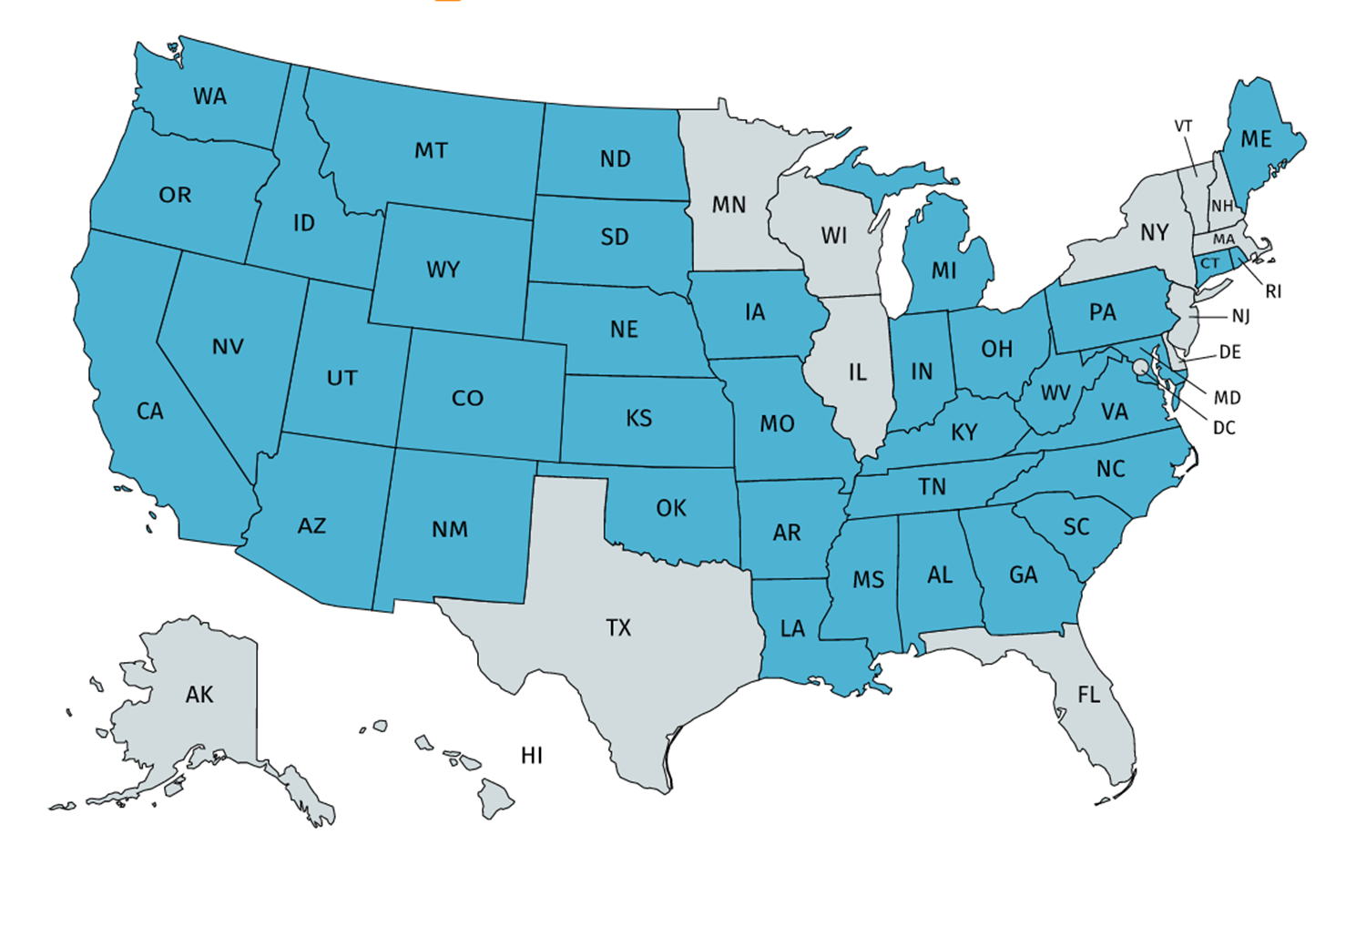
What is central property assessment?
In most states, the value of business property is determined by local municipal or county assessors.
Central property assessment, however, determines property values at the state level by the Department of Revenue or State Tax Commission.
It is typically applied to public service companies or similar businesses.
37 states use some form of central property assessment.
©Mark F. Sommer, 2019
Page 2

Slide 3
The (supposed) benefit of central property assessment
“Property tax system administration is fairest for the taxpayer when it is consistent throughout a jurisdiction. If different municipalities or other governmental sub-units within the same jurisdiction follow different rules, taxpayers can be disadvantaged. Strong central oversight is necessary for a fair and efficient property tax system.”¹
©Mark F. Sommer, 2019
Page 3

Slide 4
History of central property assessment
Central property assessment began in the mid-nineteenth century for railroads.
It’s difficult to value the property in a jurisdiction by looking at just the property in the jurisdiction given its movement.
‘Unit value’ and ‘unit valuation’ methodologies developed.
Extended to public utilities.
Considered reasonable because in exchange for greater taxation, public utilities received monopoly privileges, perhaps eminent domain, etc.
©Mark F. Sommer, 2019
Page 4

Slide 5
History of central property assessment (cont’d)
But along came de-regulation…
New non-monopoly telecommunications and infrastructure emerged.
Innovation continues to outpace regulation.
New industries have been lumped into public utility taxation.
Statutes fail to capture the breadth of new public service companies.
©Mark F. Sommer, 2019
Page 5

Slide 6
A Kentucky case study
Ky. Rev. Stat.§ 136.120 (1)(a) mentions “railroad[s],” but does not mention the internet.
Because the statute gives the department discretion to decide whether a business is “predominantly” public service, seemingly arbitrary distinctions can be made.
The most recent controlling case on this is Martin v. Producers Line Co., 113 F.2d 813 (Ky. 1940).
103 KAR 8:090, classifying PSC property, has not been updated since 1938.
©Mark F. Sommer, 2019
Page 6

Slide 7
KRS§ 136.120 defines the following as public service companies:
1. Railway companies;
2. Sleeping car companies;
3. Chair car companies;
4. Dining car companies;
5. Gas companies;
6. Water companies;
7. Bridge companies;
8. Street railway companies;
9. Interurban electric railroad companies;
10. Express companies;
11. Electric light companies;
12. Electric power companies, including wind turbine and solar generating companies;
13. Commercial air carriers;
14. Air freight carriers;
15. Pipeline companies;
16. Privately owned regulated sewer companies;
17. Railroad car line companies [ . . . ]; and
18. Every other like company or business performing any public service.
©Mark F. Sommer, 2019
Page 7

Slide 8
Central assessment of public service companies creates market failures
Public service monopolies are created to (theoretically) provide more of goods that the market would otherwise not produce – water, electricity, transportation, etc. primarily due to large, capital infrastructure outlays.
But when you tax something, you get less of it.
©Mark F. Sommer, 2019
Page 8

Slide 9
Central assessment of new technologies is impractical
It’s exceedingly difficult to value assets that are not ordinarily traded in the market.
Existing calculation methods cannot keep pace with the rapid development of new technologies.
Valuing and assessing, as a unit, an aggregate of individual assets, does not make sense when some of the assets would not be taxable if valued and assessed separately.
©Mark F. Sommer, 2019
Page 9

Slide 10
Central property assessment is inequitable to public service companies
It is virtually impossible to maintain uniformity of taxation (constitutionally required) between utility property “centrally assessed” under the unit method, and commercial and residential property “locally assessed” under the summation method. Example: solar panels on a house vs. on an abandoned coal mine.
Despite the efforts of central property assessment, similar industries are still treated differently.
©Mark F. Sommer, 2019
Page 10

Slide 11
Contact Information
Mark F. Sommer
Member
Frost Brown Todd LLC
400 West Market Street, 32nd Floor
Louisville, Kentucky 40202
msommer@fbtlaw.com
(502) 779-8150
©Mark F. Sommer 2019
Page 11

