Slide 1

Criminal Investigation
Agents of the Future
SAS Institute
Southeastern Association of Tax Administrators (SEATA)
July 2019

Slide 2

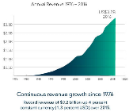




42
94%
93%
World’s
LARGEST
Of Fortune 100 Companies Use SAS
Annual customer
retention rate
Privately held
software company
Years
BUSINESS
ANALYTICS
Leadership position in
Analysts’ Validation
US$3.24B
Revenue in 2017
Revenue growth for every year of operation
14,021
SAS employees worldwide
#1
>83,000
26%
Advanced Analytics
“SAS leads in this space and it takes the next 8 competitors combined, to equal to SAS market share in advanced analytics” – IDC July 2016.
Customer sites in 146 countries
SAS revenue reinvestment
annually into
R&D
Notes:
According to IDC report July 2016, SAS is the industry leader in advanced analytics. It takes the market share of number 2 to number 9 in the list combined, to equal to SAS’ market share in the advanced analytics space.

Slide 3
Current Agencies Using SAS Analytics for Tax and Revenue
.
SAS is used to process or protect
6 of every 10 tax dollars
collected by national governments globally
*Based on analysis of 2016 OECD annual revenue collections
Countries¹
States or Provinces²
¹Four additional countries who wish to remain anonymous
²One additional state who wishes to remain anonymous
Notes:
United States Tax, Revenue & Treasury Agencies
United States Internal Revenue Service
United States Treasury Inspector General for Tax Administration
United States Department of Treasury
U.S. Alcohol and Tobacco Tax and Trade Bureau
U.S. Joint Committee on Taxation
Wisconsin Department of Revenue
Wake County Department of Revenue
Tennessee Department of Revenue
South Carolina Revenue and Fiscal Affairs Office
South Carolina Department of Revenue
Rhode Island Department of Revenue
Maine Revenue
Delaware Department of Revenue
Pennsylvania Department of Revenue
Oregon Legislative Revenue Office
North Carolina Department of Revenue
Montana Department of Revenue
Missouri Department of Revenue
Massachusetts Department of Revenue
Minnesota Department of Revenue
Kansas Department of Revenue
Iowa Department of Revenue
Florida Department of Revenue
District of Columbia Department of Revenue
Maryland Comptroller
New Jersey Treasury
California Department of Tax and Fee Administration
California Franchise Tax Board
New York Department of Taxation and Finance
New York City Department of Finance
Oklahoma Tax Commission
Virginia Department of Taxation
West Virginia State Tax Department
…and one state that does not wish to be named
Global Tax, Revenue, and Treasury Agencies
Canada Revenue Authority
Danish Ministry of Taxation
South Africa Revenue and Forecasting
Ireland Office of the Revenue Commissioners
Hong Kong Inland Revenue Department
United Kingdom HM Revenue and Customs
New Zealand Inland Revenue Department
Australia Taxation Office
Philippines Bureau of Internal Revenue
India Central Board of Direct Taxes
India Punjab Commercial Tax
India Tamil Nadu Tax
Japan National Tax Agency
Korea National Tax Service
Lithuania State Tax Inspectorate
Belgium Federal Public Service
Saudi Arabia National Tax
Finland Customs and Border
Spain Tax
Singapore Tax
Slovakia National Tax
Austria National Tax
…and four countries that do not wish to be named
Hungary Tax

Slide 4
SAS is the de facto standard for tax analytics
Tax authority clients include…
Lithuania
New Zealand
Philippines
Poland
Punjab (India)
Saudi Arabia
Singapore
Slovakia
South Africa
Spain
United Kingdom
Japan
Australia
Austria
Belgium
Canada
Canary Islands
Chile
Denmark
Finland
Hong Kong
Hungary
India
Ireland

Slide 5
SAS is the de facto standard for tax analytics
Tax authority clients include…
U.S. Internal Revenue Service
U.S. Treasury Inspector General (TIGTA)
North Carolina
Iowa
Minnesota
Wake County (North Carolina)
Tennessee
New Mexico
Kansas
New York
Delaware
California
Oregon
District of Columbia
Wisconsin
Maryland
Rhode Island
Maine
Pennsylvania
Montana
Missouri
Massachusetts
Florida
Kansas
New Jersey Treasury
New York City
Oklahoma
Virginia

Slide 6















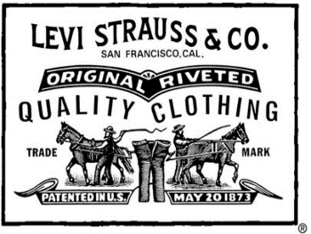













Slide 7
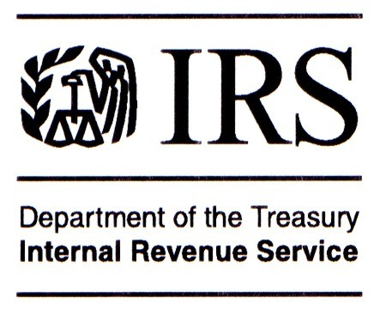
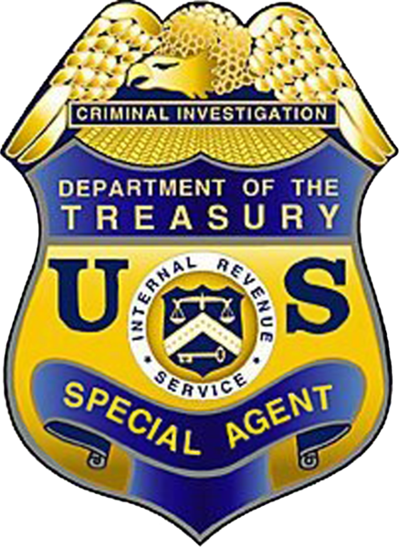
Positions Held at IRS Over 30 Years
Executive Director, International Operations (Retired)
IRS Criminal Investigation Division (CI)
Executive Director, International Operations, CI
Executive Director, Quality & Technical Support, SBSE Collection
Executive Director, Rulings & Agreements, TEGE
Deputy Director, International Operations, CI
Deputy Director, Office of Strategy, CI
Director, Office of Planning & Strategy, CI
Director, Office of Refund Crimes
Assistant Special Agent in Charge, Cincinnati Field Office, CI
Supervisory Special Agent, Newark Field Office, CI
Senior Analyst, HQ, Washington DC, CI
Special Agent, Baltimore Field Office, CI
Revenue Agent, SBSE Examination Division

Slide 8
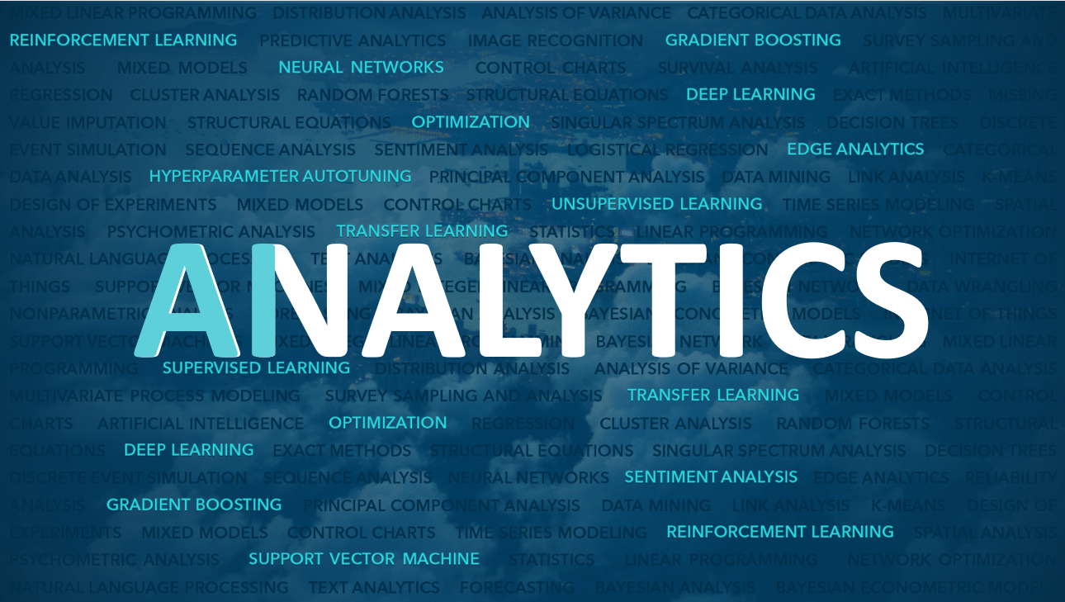


This Photo by Unknown Author is licensed under CC BY-NC
The Data Tells The Story

Slide 9
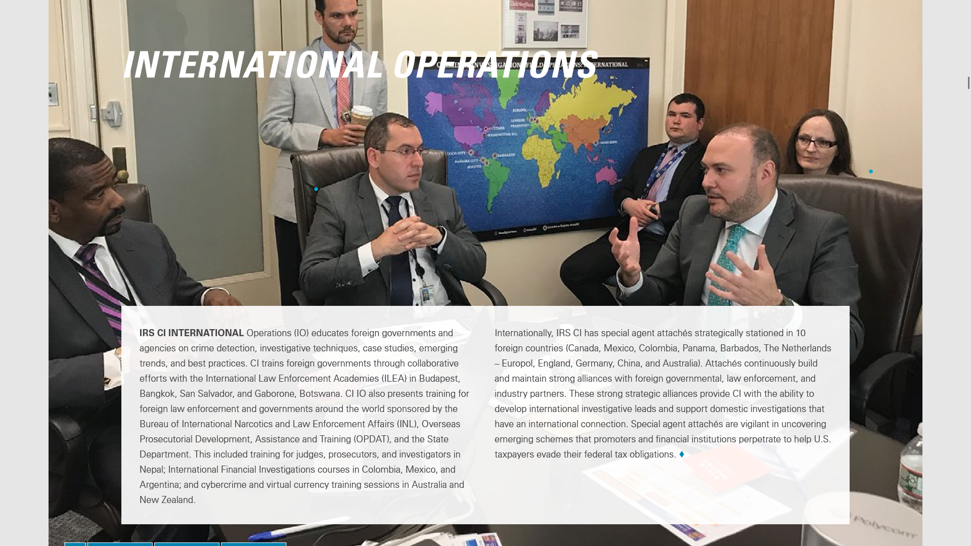

Slide 10
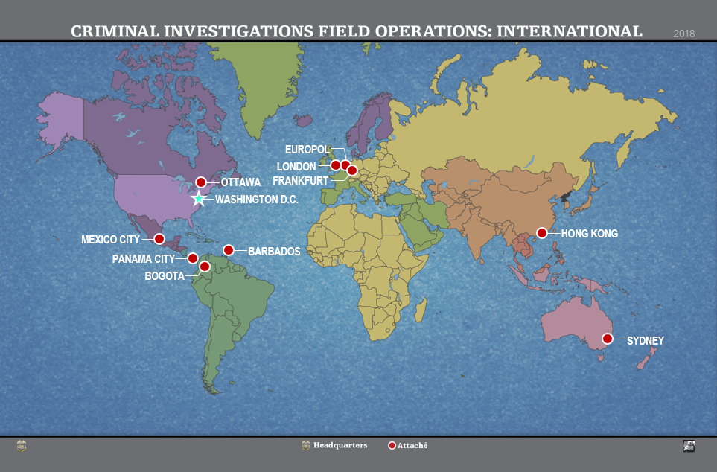

Slide 11
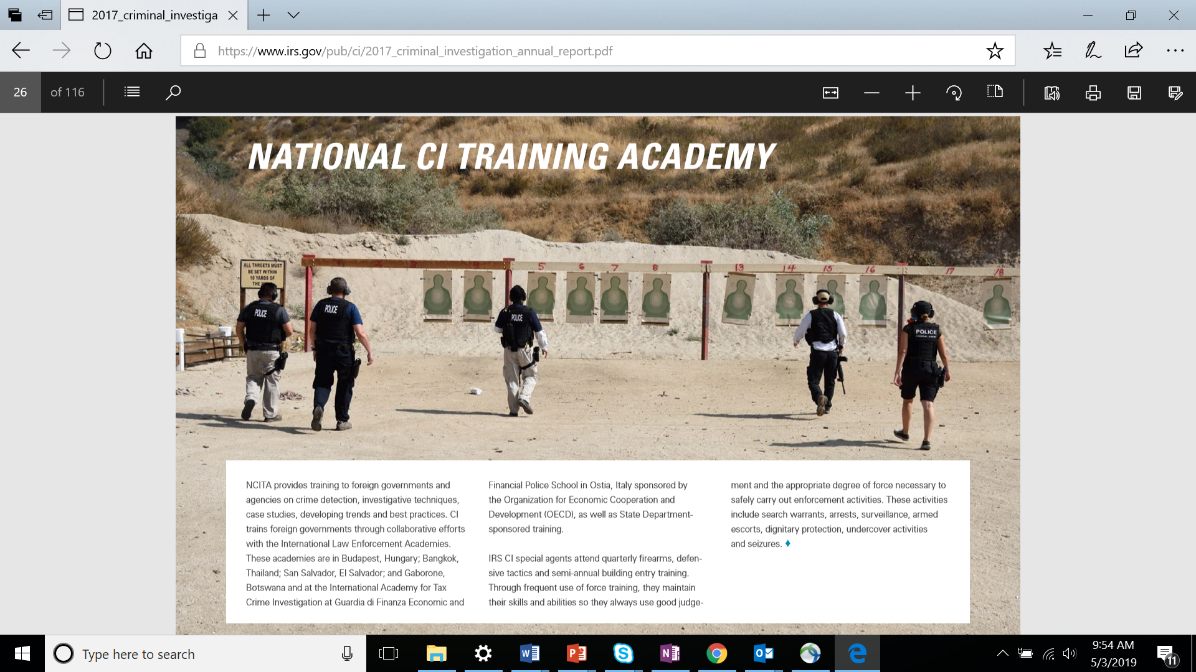

Slide 12
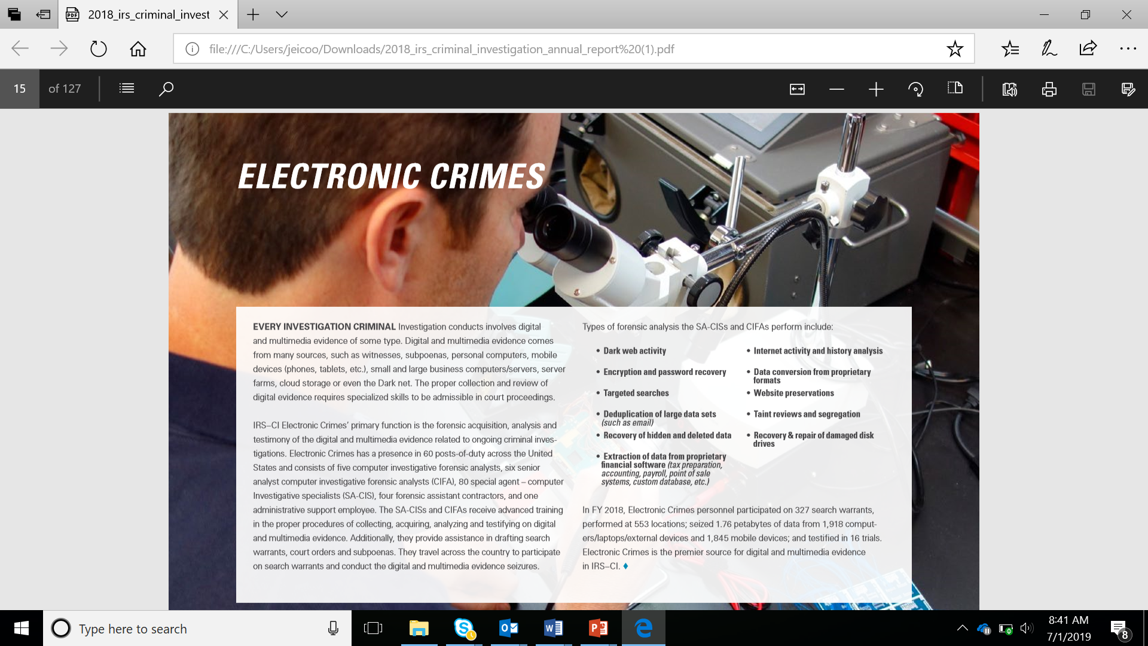

Slide 13
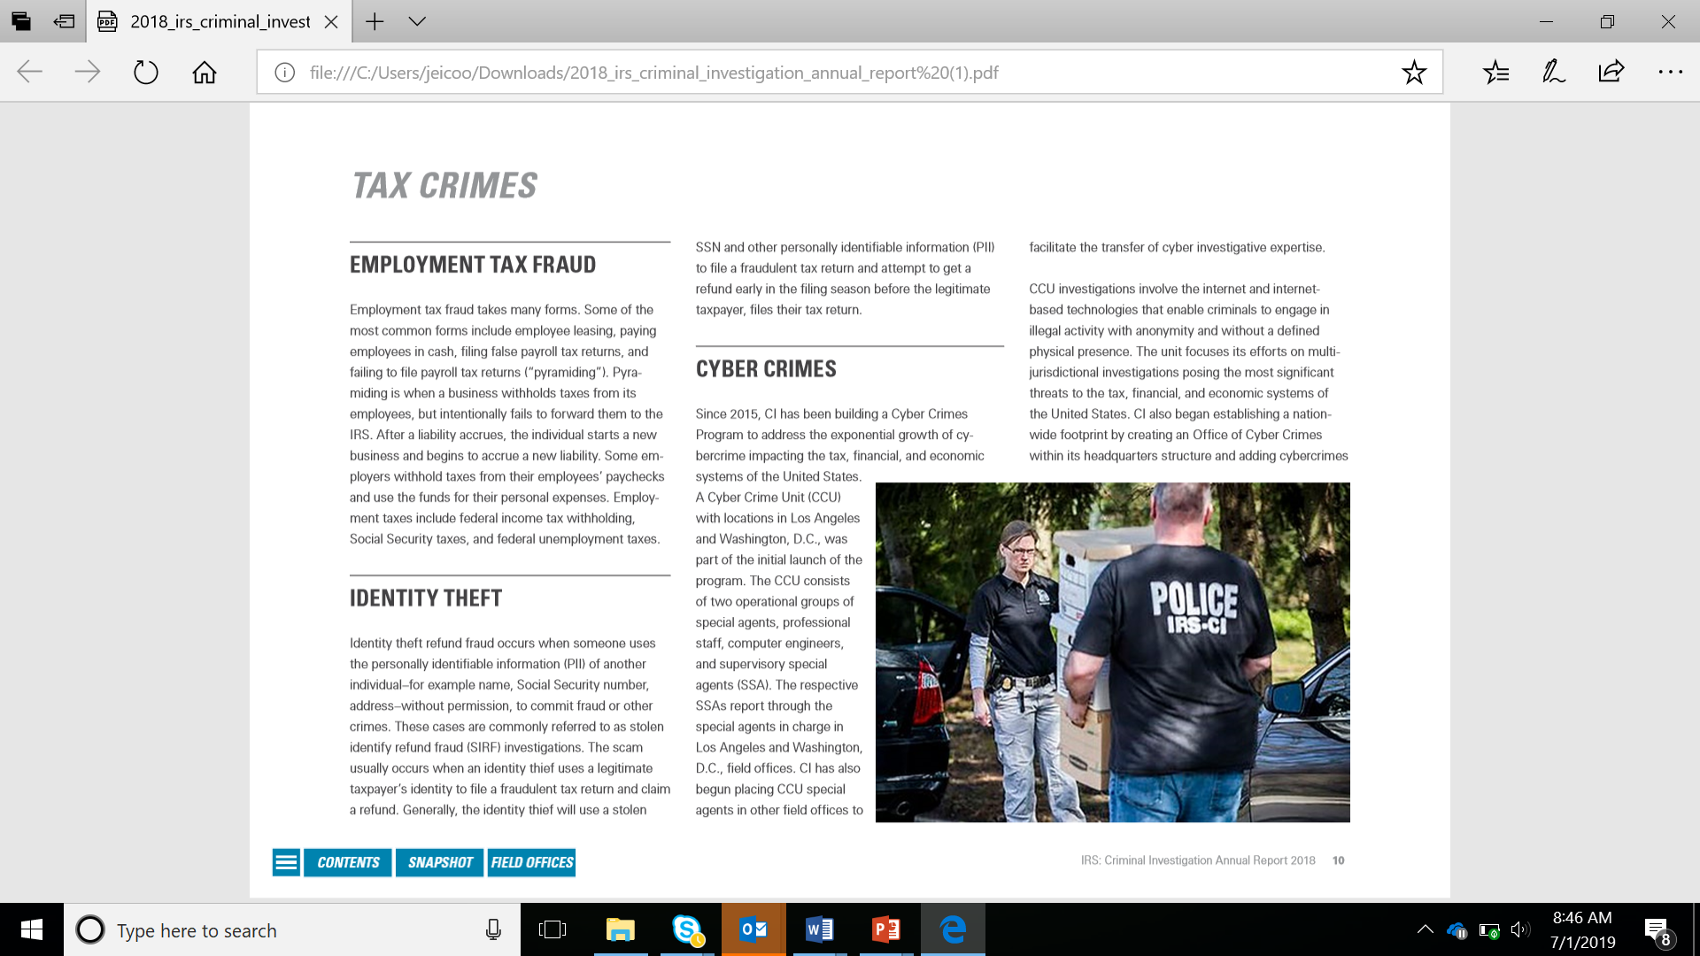
Cyber Crimes
Data intrusion, business email compromise, phishing schemes, bank account takeovers and data loss incidents.
Selling, buying and compromise of PII via internet
Virtual currency-based tax and money laundering schemes
Dark web marketplace owners, admins, and large vendors
Terrorist financing, incl. use of virtual currency, mesh networking, and other online means to raise and funnel funds

Slide 14
Crossing the Streams
Current State:
Desktop based investigation methods
Several different systems to get results. You use the one that you like, not the best one (might use 5 different computers)
Agencies collect a lot of information, but not analyzing it all cohesively – e.g. cash flow analysis for a particular industry (e.g. roofers, restaurants)
Future State:
Server based investigation methods. Agent data taken off desktop, moved to server, and merged (across cases).
One or two systems to get results. Data integrated, patterns identified, and surfaced in single user interface for agent.
Self-service data analysis tools that don’t require coding/SQL; visual for non-technical agents

Slide 15
Data Extraction from Investigation Target
Current State:
Search warrant; computers (cell phones, tablets, hard drives, thumb drives, Alexa, etc.)
Agent do all manually: 1) Extract data 2) Make it analysis-ready 3) Find the connections and patterns
CIs have typically done #1 well, but slowly. Still room for improvement in data extraction. #2-3 most room for improvement.
Swiss Bank – IRS systems vs. DOJ system compatibility issues; slowed down intelligence gathering.
Data goes in, but can’t get it out.
Future State:
Data ingestion, linkage and analysis done on site vs back at office. Example = Scanning, text mining, entity extraction, an link analysis done all in real time.
Make sure the company you engage with is cutting edge with active R&D to keep up with any data and any systems it may have to engage with. Tech keeps advancing.
Make sure you own your data! (Data goes in some systems, but not allowed to come out!)

Slide 16
Tech vs Policy
Current State:
Policy that governs global economy not keeping pace with technology (e.g. base erosion, profit shifting, crypto (BITCOIN) and virtual (VENMO)
Criminals are outrunning our policy
Lagging policy creates a problem with identifying the entity’s tax home by getting data from other countries
Issue is national and international
Future State:
Automatic Exchange of Information (EOI) – Exchange of information in real time with other tax departments worldwide
Policy and tech need to be in place to support this. Need to be forward thinking.

Slide 17
State and Federal Collaboration
Current State:
Compliance group within FTA
Tax fraud info sharing in ISAC
Otherwise, CIs are isolated – somewhat intentionally, but what are consequences of this?
But what happens with the cases that fall under IRS CI threshold (e.g. $1M in tax liab)? There’s a gap – opportunity for improvement.
Future State:
Collaboration with State police – Car stop; Person had cash and Treasury checks in car (possibly tax prep materials); often criminals move from violent crime to tax fraud (financial crimes)
Do we create a CI-focused branch of the ISAC?
Does FTA create a CI annual conference / focus group? Is there one today?
What policy need to be created legally to support this information sharing and collaboration?

Slide 18

“Whole of Government” Global approach to combatting financial fraud.
J5 Australia, Canada, Netherlands, UK and US
JITSC International Taskforce on Shared Intelligence and Collaboration
FATCA Foreign Account Tax Compliance Act
OECD Organization for Economic Cooperation and Development
CRS Common Reporting Standard
JITSIC

Slide 19
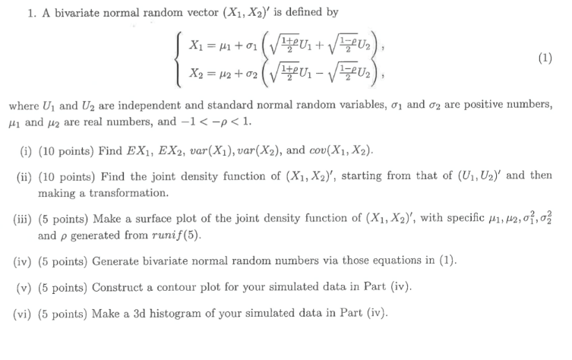
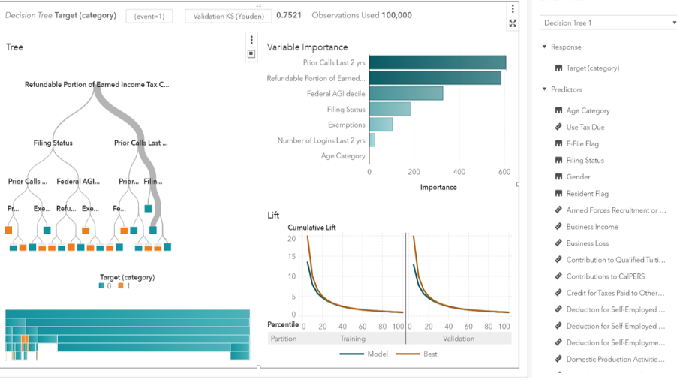
Agents of the Future: Using Math to Find Insights in Data
Taking complex math that looks like this…
…and turning into easy to use data analysis tools that look like this.
Investigators doing same thing today with Excel and sticky pads, just much more slowly. How can we help our agents find (and work) better cases faster?

Slide 20


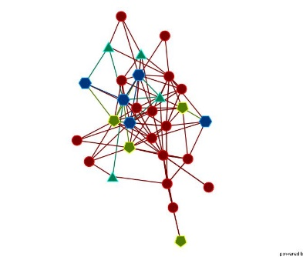


4 Main Types of Analytics Used in Tax Investigations
Predictive Modeling
Outlier Detection
Network Analysis
Text Mining
Identifies characteristics of bad tax returns
Peer groups/outliers
Connections
Unstructured data

Slide 21


Predictive Modeling – Generates a Profile of Bad Actor
Uses prior case data to teach the computer - “Labeled”
  Cat / Not Cat
  Hot Dog / Not Hot Dog
  Tax Evader / Not Tax Evader
That resulting list of characteristics is called a “model”.
That model is then used to evaluate new data for that same infraction (e.g. tax fraud, insider fraud, money laundering, cyber breach)
Model gets smarter with new case closures – More labeled data to learn from!
- OR -

Slide 22


Predictive Modeling Example
Data on Prior Cases
Computer tells us which of the characteristics have the most “predictive power”. If > .7, considered highly predictive.
Adjusted Gross Income Decile
Tax liability due
Filing Status (Married, Single)
Medical expenses
Charitable Contributions
Geography (e.g. region)
.80
0
.64
.01
.75
.92
New CI Case Leads Generated
Runs on new data
Feedback loop
Computer ingests all of the prior cases that were successful and unsuccessful
Model gets smarter over time if case outcomes are fed back in. Feedback loop not automatic, needs to be configured to do this.

Slide 23
4 Main Types of Analytics Used in Tax Investigations
Predictive Modeling
Outlier Detection
Network Analysis
Text Mining
Identifies characteristics of bad tax returns
Peer groups/outliers
Connections
Unstructured data

Slide 24

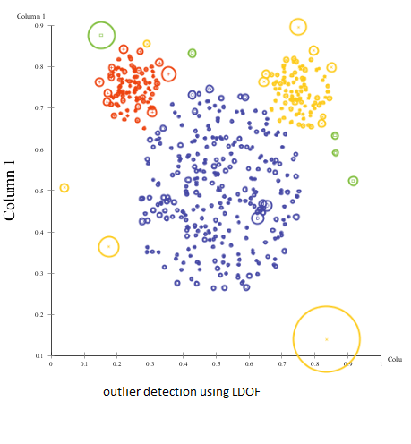
Outlier Detection
Computer groups taxpayers by like characteristics (“peer groups”) and looks for taxpayers who fall outside
Used when past case data not available or reliable
Helpful to find new segments to investigate that were previously ignored (e.g. nail salons vs restaurants), or for forensics purposes to find financial transactions or activities that are aberrant.
This Photo by Unknown Author is licensed under CC BY-NC-ND

Slide 25
4 Main Types of Analytics Used in Tax Investigations
Predictive Modeling
Outlier Detection
Network Analysis
Text Mining
Identifies characteristics of bad tax returns
Peer groups/outliers
Connections
Unstructured data

Slide 26
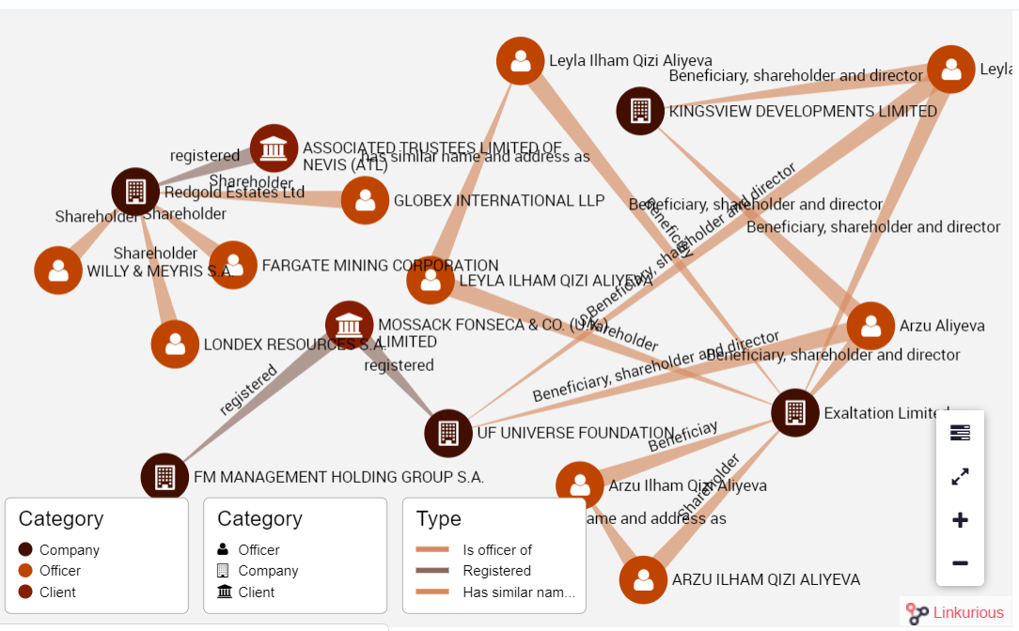
Network Analytics (Connections)
Networks are built on the implicit relationships between individuals and companies (for example, people who share addresses, phone numbers, or bank accounts). Not all fraud is networked, but much is.
Particularly useful for complex cross border activities and to see “social networks” of suspect individuals.
Take down the network not just the individual.
Corporate structure easily revealed and visualized
Complex flow of financial transactions can be followed
Structures and transaction flow can be identified as “high risk”

Slide 27
Fraudulent Tax Preparer
Tax preparer associated with flagged return.
9 other tax returns associated with same preparer. They have also been flagged for fraud, for the same reason.
Original tax return flagged for alert due to unusual deductions.
Case turned out to be 10 tax evaders and 1 criminal tax preparer working in collaboration

Slide 28
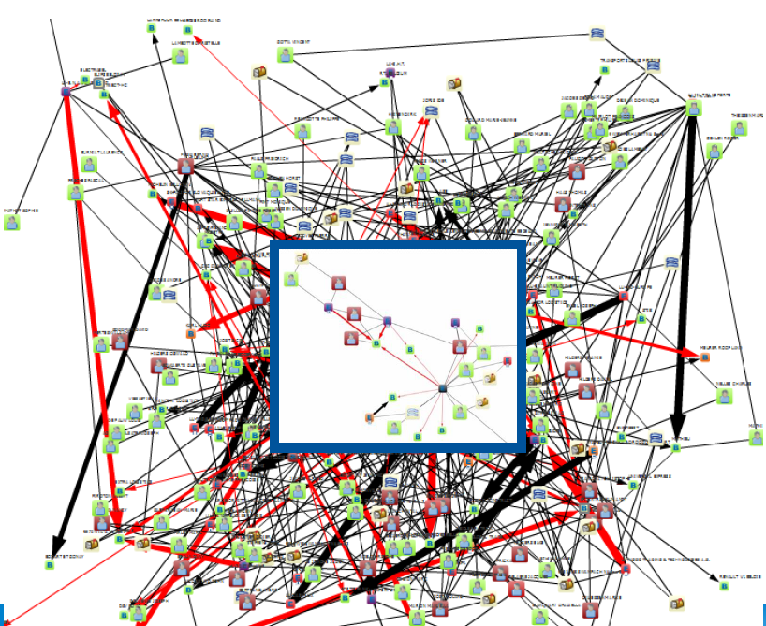
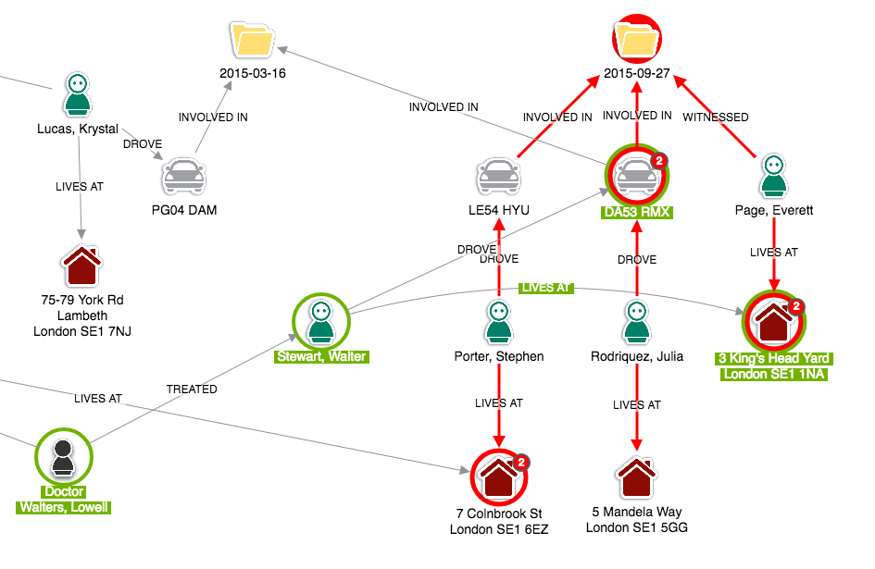
Untangling the Knot
Super Clusters

Slide 29
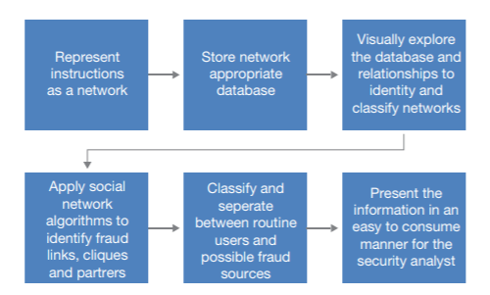
Network Analytics
Much More Than a Neat Diagram
Strength or frequency of interaction
  Modeled as weights (strong or weak link) on the links of the resulting network
Network Metrics
  Degree – How many transactions; size of transaction
  Influence – Large transaction in sea of small ones
  Closeness – 1 hop away vs. 5 hops
  Centrality – Identifies the most important entities in a network
  Hub – What is central point
  Betweenness – Who has the ability to control info flow (“gatekeepers”)
  Eigenvector – How many high influence nodes are you connected to? (guilt by association)
Perform network optimization based on a set of algorithms such as clique, cycle, shortest path, minimum-cost network flow, linear assignment, minimum spanning tree, minimum link-weight cut, transitive closure, and traveling salesman problem

Slide 30
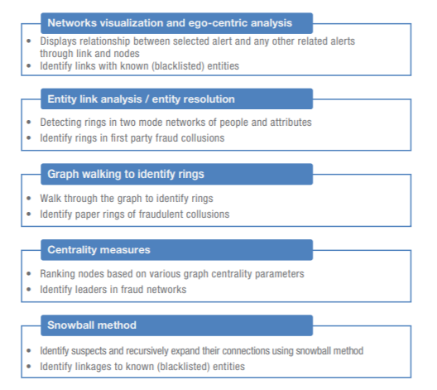
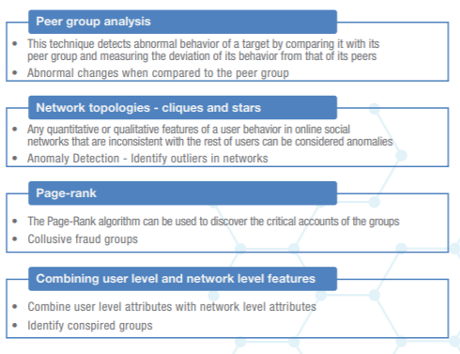
Network Analysis Techniques

Slide 31
4 Main Types of Analytics Used in Tax Investigations
Predictive Modeling
Outlier Detection
Network Analysis
Text Mining
Identifies characteristics of bad tax returns
Peer groups/outliers
Connections
Unstructured data

Slide 32
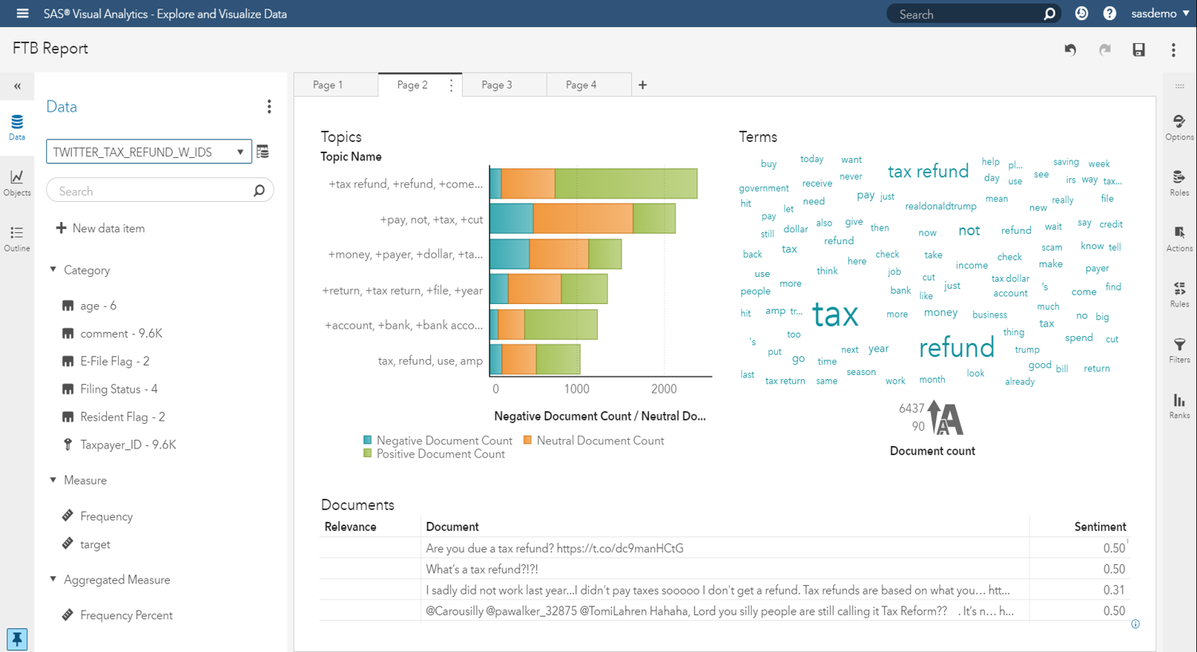

Slide 33
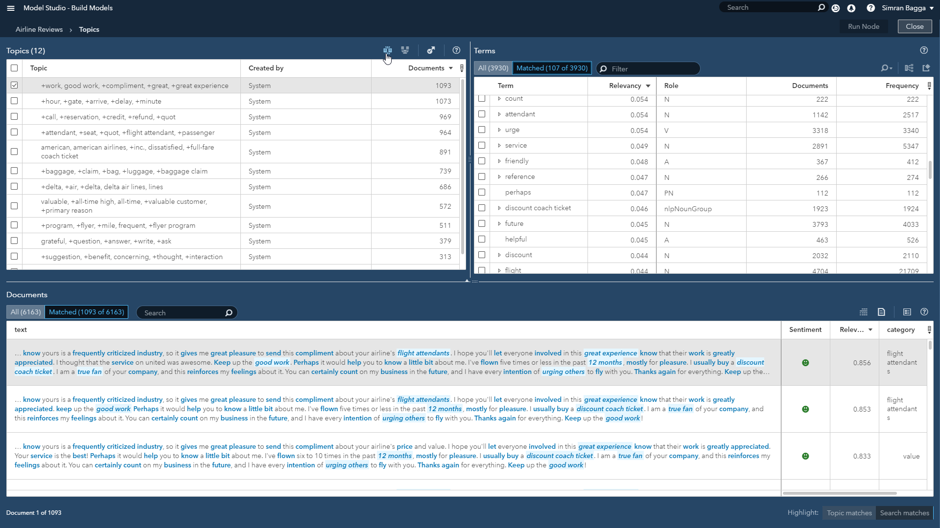

Slide 34
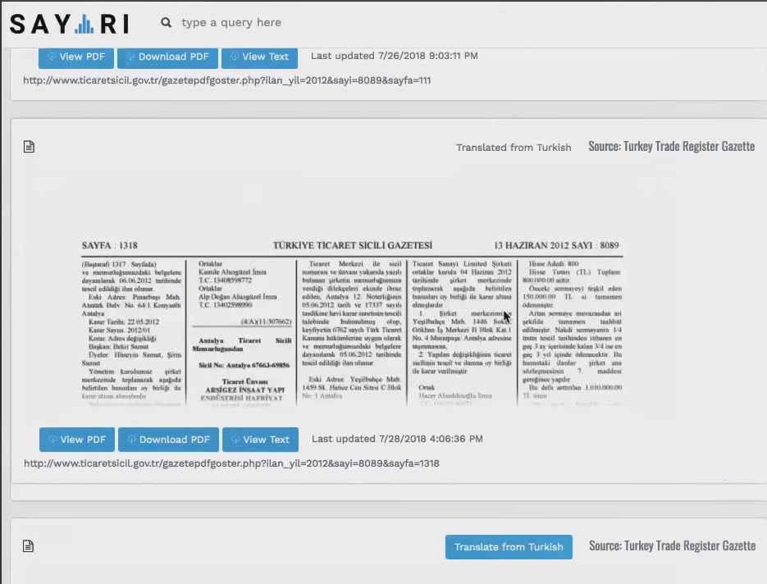

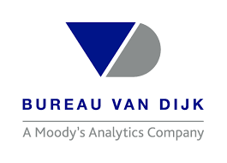
Text Mining/Web Scraping – Open Source Intelligence
Malta
Aruba
Bahrain
Curacao
Lebanon
Mauritius
Panama
Cambodia
Laos
Greece
Romania
Uzbekistan
Iceland
Montenegro
Latvia
Russia
Liechtenstein
Madagascar
Puerto Rico
Peru
Africa
Switzerland
Maldives
Venezuela
UK
Mexico
China
Hong Kong
Indonesia
Macau
Papua NG
Philippines
Taiwan
Thailand
Vietnam
Middle East
United States
Moldova
…..etc.
Data comes in native language and translated, then linked to tax authority data (and other external data).

Slide 35
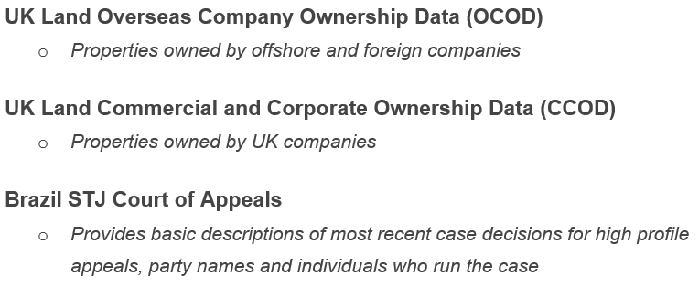
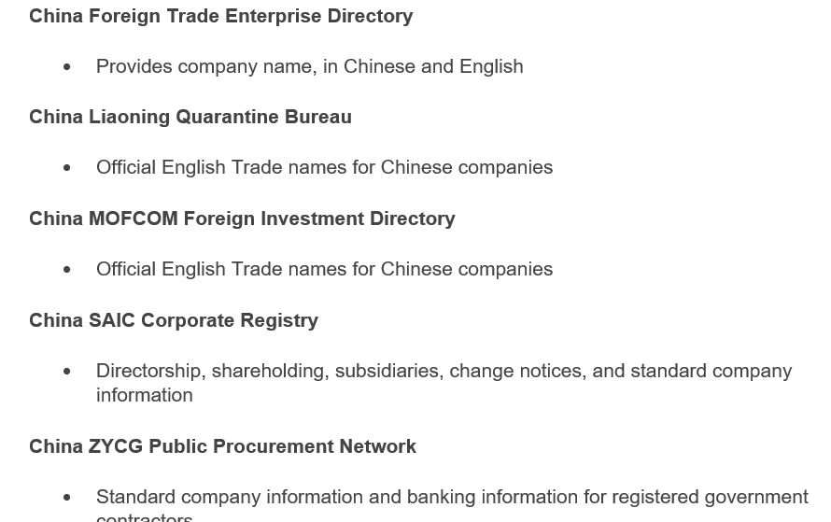
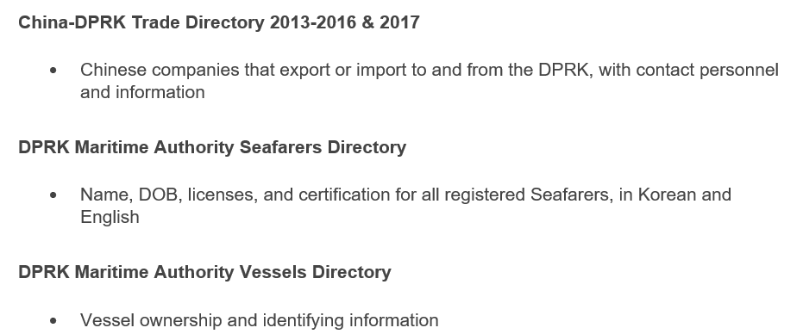
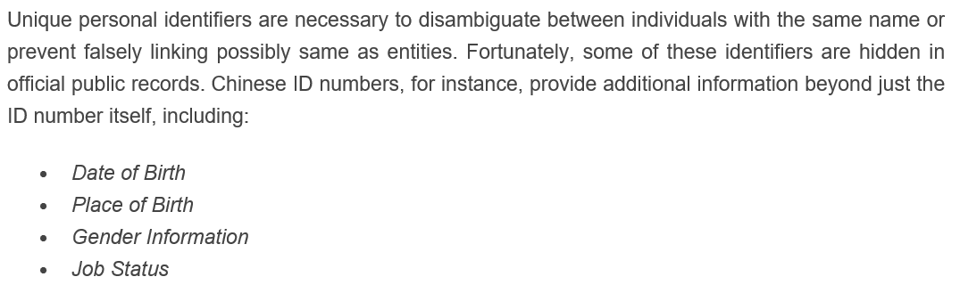

Slide 36
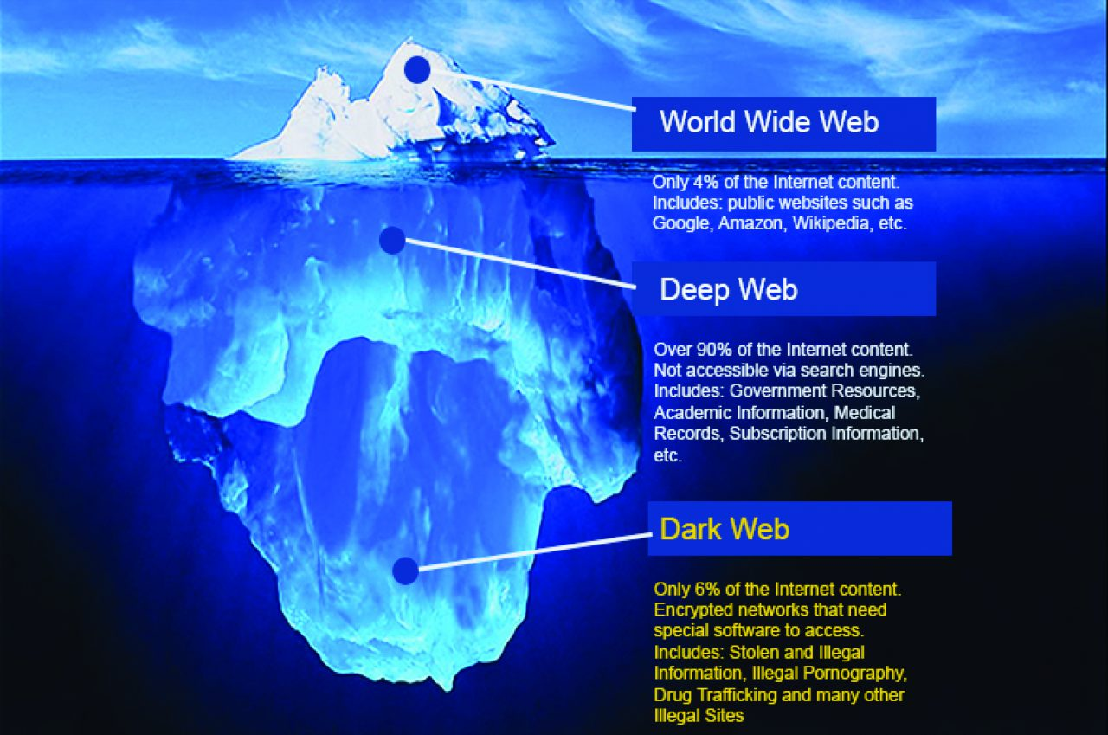
CI Use Case:
Dark Net Monitoring
Agora Marketplace
Analytical Techniques
in Action
HTML scraped and parsed
Intensive ETL/data Cleansing process
Loaded into investigative user interface for exploration
Text analytics, network analytics, risk scoring

Slide 37
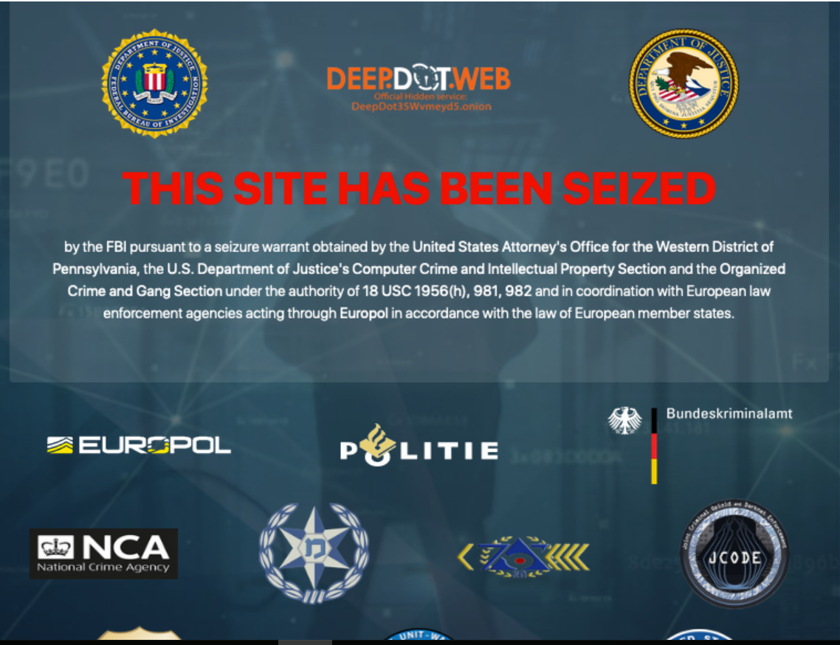


Global Collaboration is Increasing
Joint International Take Down of “Wall Street (DarkNet) Market”
U.S. Department of Justice (DOJ), Internal Revenue Service (IRS), Federal Bureau of Investigation (FBI), U.S. Drug Enforcement Agency (DEA) ,HSI, U.S. Postal Service, Interpol, Europol
Germany, Netherlands, Brazil, U.S. and Eurojust.
Significant assistance from Criminal Division’s Office of International Affairs and Organized Crime and Drug Enforcement Task Force Program.

Slide 38

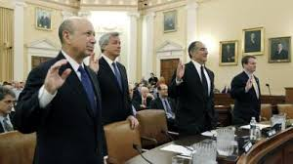
Professional Enabler Investigations
Tax authorities are not just going after tax evaders themselves.
Some enter into non-prosecution agreements with tax authorities under which they agree to surrender information on their clients transactions, and pay penalties
As of September 2018, over 80 banks had made such agreements with the United States under Swiss Bank Program.
Data can be used for modeling!

Slide 39
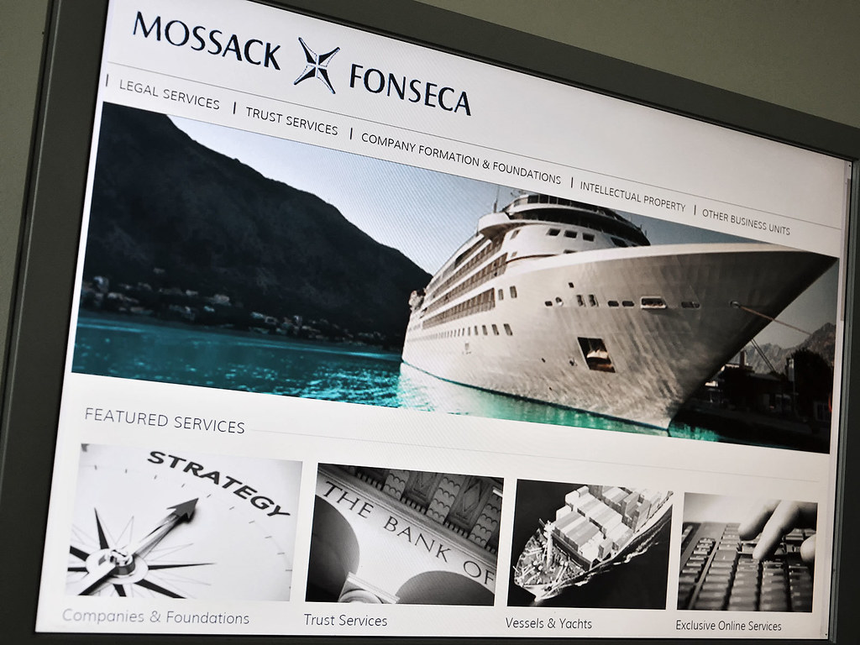
Professional Enabler Investigations
4 people charged – Tens of millions; scheming for decades
Former investment manager, a former U.S. resident, an American accountant and a Panamanian lawyer who once worked for the firm
11 million documents, which a consortium of journalists made public in April 2016

Slide 40
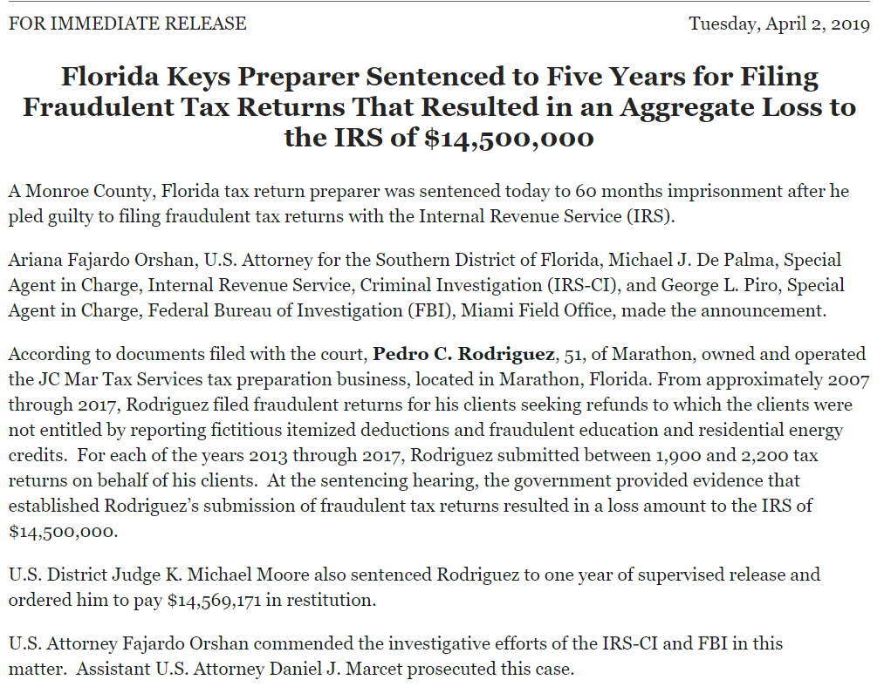
From 2007-17, Rodriguez submitted ~2,000 returns per year for his clients.
Fictitious deductions and fraudulent education and residential energy credits.
For one client, he claimed $6K in solar water heating, $9K in mortgage deductions, $13K on job expenses and others totaling $31K – none of which was true.
Would give clients paper copies of final returns which did not show the deductions/credits.
Charged between $80-$120 for preparation fees to his clients.

Slide 41
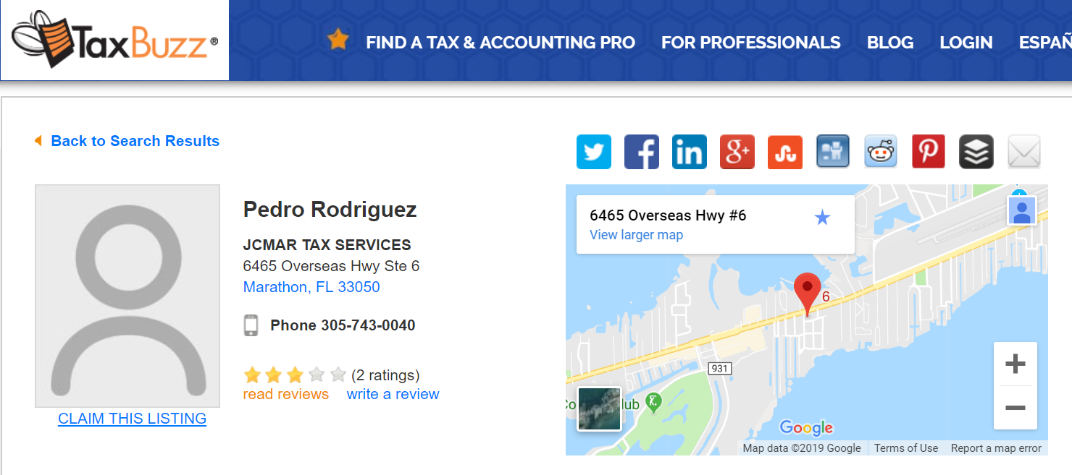
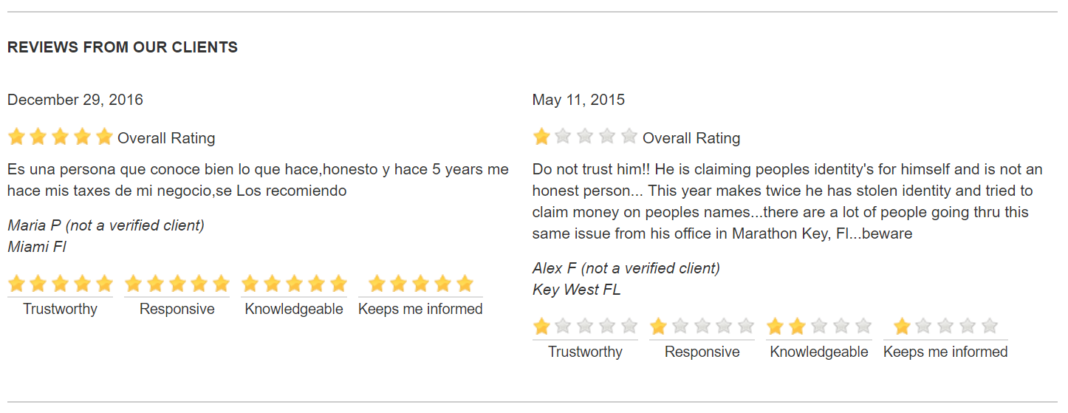
The best part. Internet review in 2015. Could it have been stopped earlier by scraping this data, and connecting it back to the tax returns filed?

Slide 42
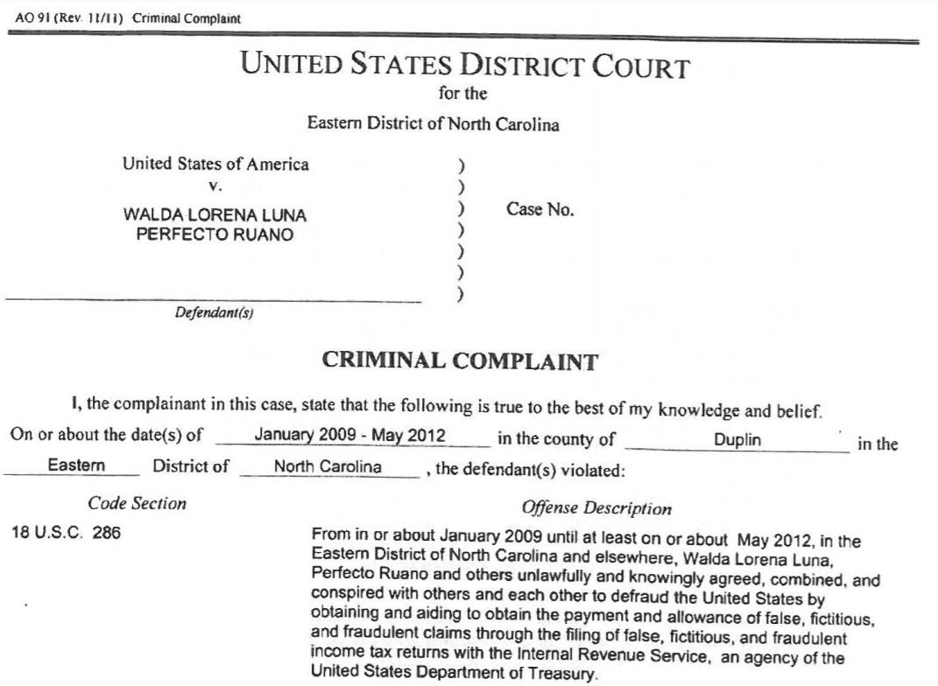
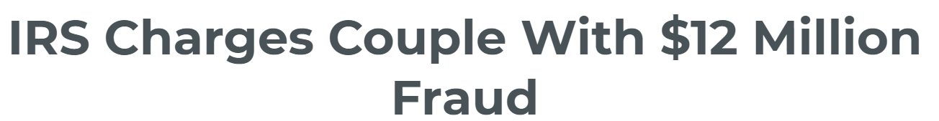
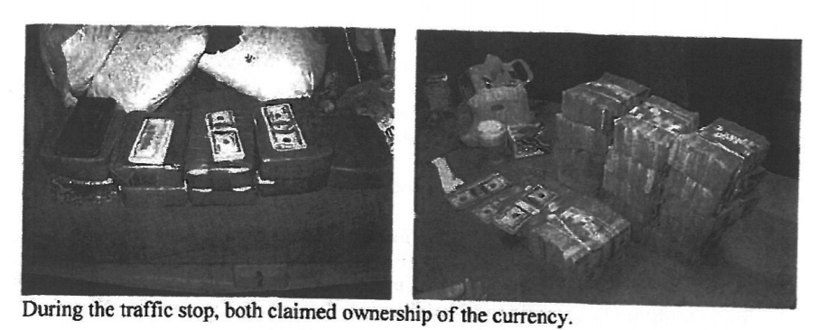
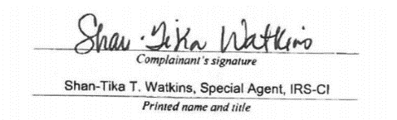
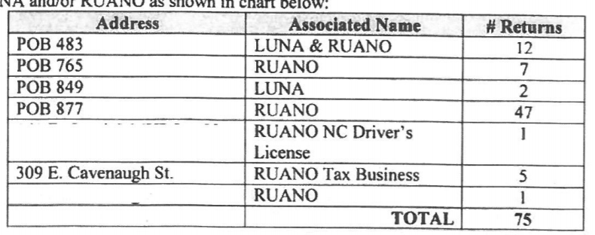
In 2014, two North Carolina-based retail business owners found with $1.789M in cash in vehicle by Arkansas State Police.
Found business ledger in their home consistent with illegal tax prep services.
Officers seized 9 foreign ID documents, 300 ITIN letters, 113 tax related records, 179 W2s, and other ledgers indicating returns filed and refund status.
Computer seized had TaxWise software files for 229 “clients” for 2008-11.
5 common employers and mailing addresses across many (75) of the tax returns

Slide 43

In Summary
DO Cross the Streams - It is no longer enough to work in parallel on separate cases, but rather move towards a vision where both the agents (and their case data) are connected, thereby revealing overlaps and insights not previously realized.
Everyone Can (and Must) Contribute– Enable your entire organization to do data analysis and intelligence gathering regardless of their technical skillset (or lack thereof). The line between “agent” and “data analyst” is growing thinner by the day. Fit-for-purpose user interfaces and capabilities must remain a focus for the organization.
New Data Sources - PDF, Word, Excel, text, images, voice…resting in a database or on a PC…or even streaming in real-time from the edge. The clues aren’t just in DB2 and SQL Server anymore.
Play Video – Ghostbusters “Don’t Cross the Streams”

