Slide 1
Revenue Processing Center Payments Processing Overview
Vince Panepinto
Director, RPC
Louisiana Department of Revenue
July 2019

Slide 2
Presentation Overview
LDR RPC overview
Payments processing workflow
Data Validation Analyst responsibilities
Problems and solutions

Slide 3
LDR RPC Overview
Staffing
Full-time staff: 80 employees
Part-time staff: 20 employees
Temp workers for “rush” season: 50 employees
Sections
Support Services
Doc Prep
System Operations (Sys Ops)
Data Validation (DV)
Central Registration
Quality Control (QC)
Data Capture and Corrections (DCC)
Document Control Unit (DCU)
Account Maintenance
Special Tax Programs
Administration

Slide 4
Payments Processing Workflow

Slide 5
Payments Processing Workflow

Slide 6
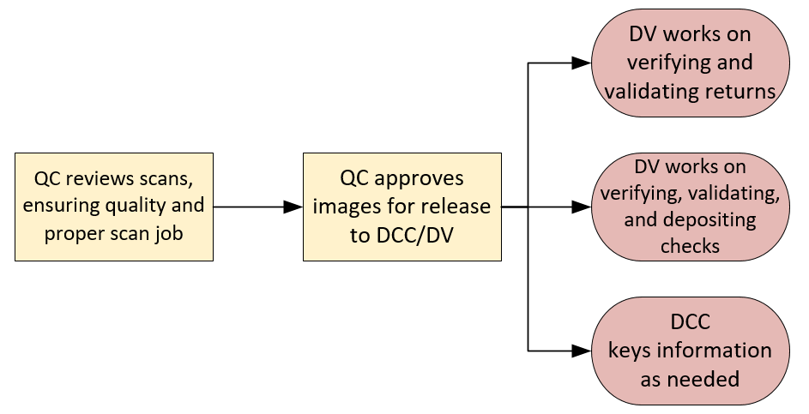
Payments Processing Workflow

Slide 7
Job Duties
Specialists
Paper Send Back and Send Back Queue
Withholding Research
Declaration Review
Duplicate Media
“Can’t Find Payment” Work Items
General Suspense
Research
Refund Memos
VIP and No Access
Analysts
Daily Deposits (4)
Balancing (with Financial Services)
Balancing (with Tax Express)
Research Adjustments
Paper Tracker
Validation
Non System
Tax Disclosures
Cash Transmittals

Slide 8
Analysts
Revenue Deposit 21 (Image Cash Letter, or ICL)
This deposit is processed daily. It consists of funds processed through RPC within the last 24 hours.
These checks meet all the proper criteria needed to be deposited into the bank electronically.
Once the checks are scanned and/or keyed they are transmitted to Chase Bank in increments of 3,000 per bundle.
Checks are being scanned and processed with a cut off at 2:00 p.m. However, the processing of checks continues to run for the next business day’s deposit.

Slide 9
Analysts
Revenue Paper Deposit
This deposit is also processed daily. It also consists of funds processed through RPC from the last 24 hours.
But, they do not meet the proper criteria to be deposited electronically. Either it’s a foreign check, the scanner can’t read it, or the MICR line is not legible.
The physical checks are routed from Sys Ops to DV. Each check has to be verified and processed in Verify Pull (TE). The checks then have to be scanned and processed in Receivable Edge with Chase Bank.
Once completed, reports are generated and the Analyst must ensure that Tax Express, Tangent and Chase Bank are all in balance.
If the deposits are out of balance the Analyst must research and resolve all discrepancies. Once all reports are in balance daily deposit totals are emailed to the Admin, and Financial Services units.

Slide 10
Analysts
Balancing with Financial Services
Reports are received each day from Financial Services/Chase Bank for the previous deposit date. Chase Bank is providing us with the information they received from us, and we must once again validate that the totals from all deposits are in balance to what the bank received.
If there are any discrepancies in the figures we sent to them and what they received, we must correct the problem and resend any corrections.

Slide 11
Analysts
Balancing in Tax Express
Whenever the amount owed line on a return does not match the dollar amount of the check, both items are routed to a queue in Tax Express called Balancing. The Analyst has to verify that the check is deposited in the bank for the amount the taxpayer intended it to.
The written amount on the check is the legal amount, so whatever the taxpayer wrote on the line is what we will submit to the bank.
If the block amount and the written amount of the check differ by more than $100.00, the check will be deleted and sent back to the taxpayer with further instructions. Once the check has been corrected, we process it and release it to be deposited.

Slide 12
Analysts
Research Adjustments (Bank Errors)
In the event that a check is deposited into the bank for the wrong amount, the bank will notify us through means of a research adjustment.
Periodically, if the image of a check is bad and the DC Operator can’t read the dollar amount on the check, the wrong amount can be keyed and encoded on the check.
If it passes all of our check points and reaches the bank, then the bank should catch it, correct it, then send us the adjustment. We then have to go into DELTA and adjust the taxpayer’s account and notate CRM notes explaining what happened.
If a taxpayer calls in stating that we withdrew the wrong amount from his bank account, then we have to research what happened and initiate a research adjustment if necessary.

Slide 13
Analysts
NCI (Non-Conforming Image) Research Adjustment
This occurs when the check has met all of LDR’s criteria but didn’t meet all of Chase Bank’s criteria. It could have been a bad image of the check or the bank name is not legible or missing on the check.

Slide 14
Analysts
Cash Transmittals
Whenever LDR receives a cash payment from a taxpayer, an impressed check has to be created for the payment to be processed.
The Revenue Tax Analyst receives emails from the Document Preparation Unit to inform them when they have delivered a Cash Transmittal to TPS. The email received from the Document Preparation Unit will include the Cash Transmittal number, Taxpayer’s name, Taxpayer’s account number, and the amount of the Cash Transmittal.
The Revenue Tax Analyst will wait until the matching Pink Cash Transmittal Form is received before verifying the Cash Transmittal has posted correctly.
Once we have both the email and Pink Cash Transmittal Form, the Analyst processes/verifies the Cash Transmittal in DELTA.

