Slide 1
SEATA 2019
Orlando – July 16, 2019

Slide 2
Joined Avalara in 2012
Previously served as the Executive Director of the Streamlined Sales Tax Governing Board, Inc. and the Director of the South Dakota Sales Tax Division
Accounting Today’s 100 Most Influential People in Accounting – 2018
Scott Peterson
Vice President of U.S. Tax Policy and Government Relations
Avalara

Slide 3
Avalara
What we’re up to
HQ in Seattle with offices in in the U.S., Canada, Europe, Brazil, and, India
25,000+ customers
1,600+ partners
700+ pre-built integrations
9.5B transactions processed in 2018
1M+ returns processed in 2018
$36.2B prepared for remittance in 2018

Slide 4
Teamwork makes Dreamwork
▪ Compliance / Processors ▪ Treasury - Global Payments Team ▪ Content (Rates and Boundaries) ▪ Reconciliation Team ▪ Support Team ▪ Engineering Team with a focus toward Automation ▪ Developers / Mappers

Slide 5
2019 Returns Highlights
U.S
8,000 Customers
2.2M Returns filed
Sales and Use Telecommunications Excise Tax Fuel Tax Alcohol & Beverage VAT Lodging and Hotel
Notes:
Nichol owner
Liz to send wiki on Brazil -
Wayfair.vs.SD FSC decision is paving the way for states’ to swiftly adopt economic nexus, where simply selling into a state without physical presence closes a major revenue gap for many state jurisdictions.
In addition we have mega trends across our AvaTax, Lodging and Comms return business. These drive the need for growth fueled by technology.
Avatax – Go big, pursuing more enterprise customers as part of the overall growth strategy. Big names and big deals – builds post IPO momentum.
Comms – Tier 1 transformation just off the heels of the raising a new team in Durham and ss efficiencies to enable the team to take on larger enterprise clients, as well as the pursuit of margin improvement. This year we are adding names like GM/Onstar and Sirius XM to our customer list in 2019 and 2020.
Lodging….Vast and growing market with new entrants driving new opportunities. to list your home on multiple platforms. Jurisdictions have increased their focus on vacation rentals compliance, adding complexity as platforms are negotiating special rates. This is making our MyLodge more valuable as home owners need this service and we are the only provider servicing this market. Huge opportunity in front of us especially as we start integrating with listing platforms and allow customers to opt in for our service from there.
Increasing gross margin and decreasing risk are significantly impacted by the level of product automation.

Slide 6
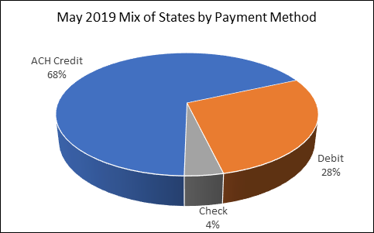
Remittances
Notes:
Out of 50 states & territories with sales tax, 34 use ACH Credit, 14 debit, and 2 checks.

Slide 7
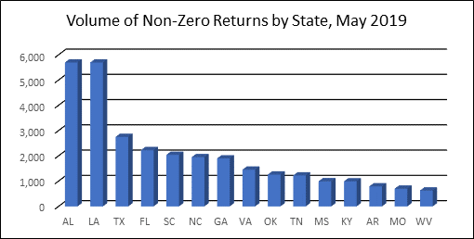
Remittances
Non-zero returns

Slide 8
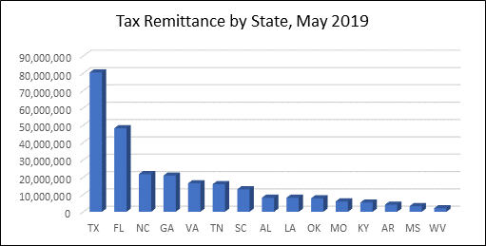
Remittances
Tax remittances
Notes:
The total remittance for these states in May was $260+million.
There were 30,293 returns in May with an associated payment.
16,360 by ACH credit
735 by check
13,198 by debit

Slide 9
ACH Credit States
ACH Debit: 1) AL 2) CO 3) DE 4) GA 5) IA 6) LA 7) MD 8) NE
9) NY 10) PR 11) SC 12) WV
= ACH Credit = ACH Debit = No Sales Tax

Slide 10
ACH Credit Benefits / Risks
Benefits
One lump sum payment to the state; as opposed to hundreds of thousand debits
Reduce payment friction
Reduced fraud opportunities
Environmentally friendly, as opposed to paper checks
Streamline payment cycle
Financial controls over all payments
Accuracy
Speed – delivery of payments
Risks / Concerns
If due date, liability is incorrect, all payments submitted/debited at once
ACH Credit file must be sent to the bank one business day earlier to settle; therefore the filing must be complete at that time also.
Taxpayers do not always see confirmations and inquire to us concerned
Avalara desires partnerships with State representatives to forge forward opportunities to make this process more seamless

Slide 11
Returns
Over 1 million returns remitted every year
We have approximately 2,100 returns in our inventory
Sales, lodging, communication taxes and motor fuel taxes
Approximately 616 of them are sales and use tax returns
Approximately 80 of these forms we only support for manual filing where customers call in their values every month for filing:
Examples of manual returns include:
B&O Tax returns
Retail Incentive Zones returns
Commercial Activity returns
Rental, Leasing and Motor Vehicle returns

Slide 12
Global Returns Services
Promote Employee & Customer Experience
Share Best Practices
Manage Risk under Compressed Deadlines
Drive Automation
Register
Manage Data
Remit Payments
Prep/File Returns
Manage Notices & Support Audits
Onboard
Notes:
Kim (own) and Patricia to collaborate
Bullets in orange banner are the common themes that unite our leaders and team members.
End 2 End services for Compliance – many elements common across our teams however some of the complexities and element (such as registrations) vary on how we deliver – shared services in partnership with team outside of Compliance vs. all resourced and delivered from within.
We are customer facing - be it with jurisdiction or customer level responsibilities.
Depth and complexity across a common suite of services that each of the businesses provide.
Call out on Registrations - EMEA – VAT regisrations. Kim on Lodging – both registration and renewal. Compli bulk registration. Comms does registrations. Sales and Use Tax (AvaTax) Returns team does not do registrations – handled via Business Licenses.com (partner)
Risk management varies across the businesses – in the U.S. there is both filing as well and remittance/payment responsibilities that could lead to penalty & interest paid by Avalara. What about EMEA and Brazil?
We also build relationships with various jurisdiction – DOR Direct in the U.S. to further automation and technology is an example – where we aim for thought leadership. Researching and resolving notices is another area where we learn from as well as share back ideas to make things easier for the jurisdiction (and tax payers).

Slide 13
State Summary Filing Capabilities
States | Bulk Account | Transmission Capabilities | ACH Credit | Upload Capabilities | TAP Website | Multiple Websites
Alabama
Arkansas
Florida
Georgia
Kentucky
Louisiana
Maryland
North Carolina
Oklahoma
Tennessee
Virginia

Slide 14
Administrative Considerations –
Types of Live e-Reporting
E-Invoicing
Live reporting
Hungary
Copy of invoice sent
to GVT immediately
Digital seal recorded on invoice
Order
Bill
Invoice/ credit
Post
Ledger
Report
“Invoice authorisation”
“Pre-clearance”
“Post-clearance”
Brazil
China
Italy
Invoice issued
through GVT
Spain
High frequency batches
of invoices sent to GVT
Call to GVT to get
permission to issue
invoice
India
Proposal invoice issued
through GSTN

Slide 15
Q&A

