Slide 1
A Bowl of communication soup to nuts
An Inside Look at Correspondence between Taxpayers and Revenue Agencies in a Digital Era, and What Happens to All that Information

Slide 3
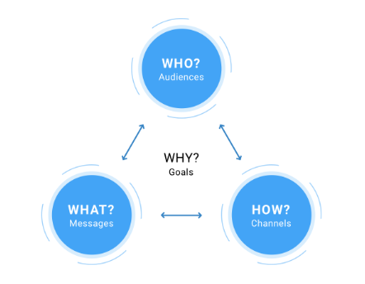

Slide 7
Social Media
Letter Correspondence
Phone
Chat
E-mail
Print
Online
Portals
Fax
Radio / TV

Slide 8
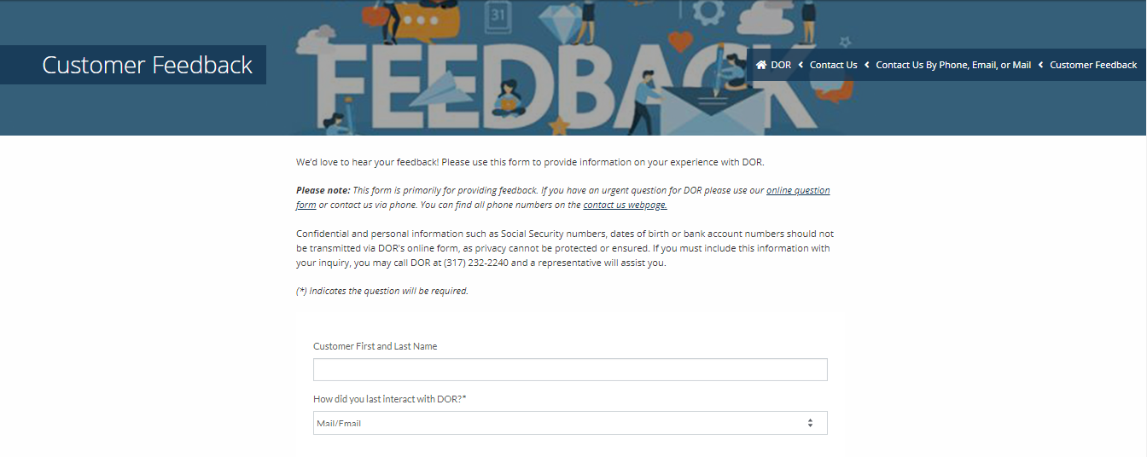
Feedback.dor.in.gov

Slide 9
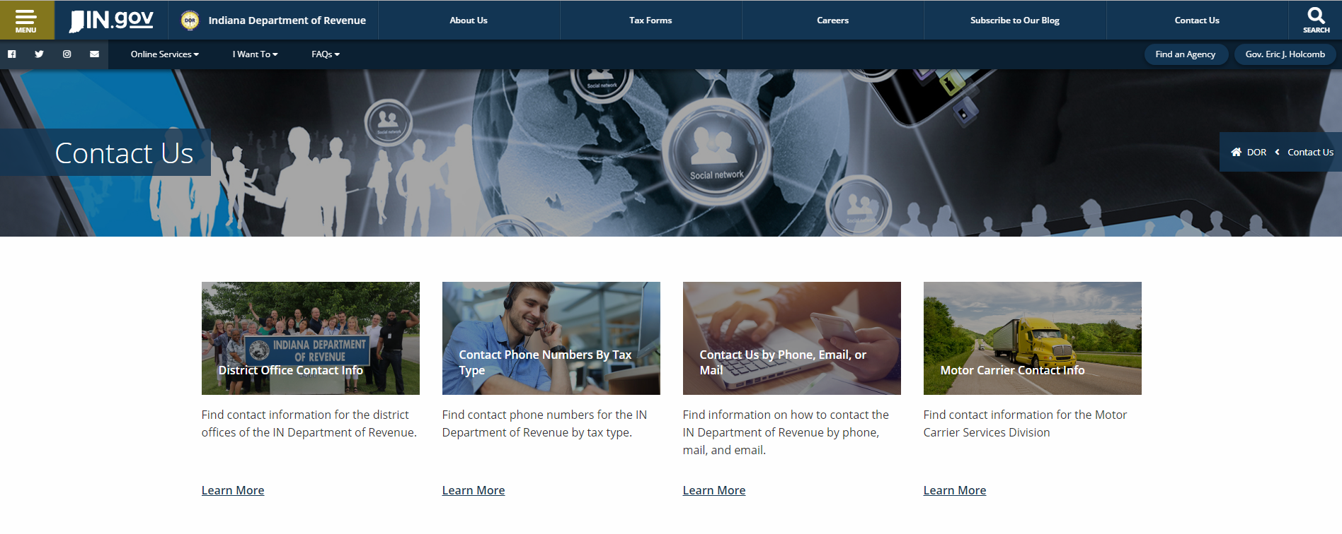

Slide 13
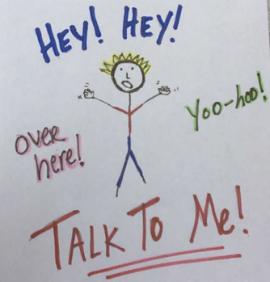
Strategic
Targeted
Fun / Engaging
Proactive

