Slide 1

Alabama Department of revenue
Wholesale to Retail Accountability Program
WRAP

Slide 2
WRAP Law
Act 2017-294, codified Code of Alabama 1975, §40-23-260, established the wholesale retail accountability program, requires new information be provided to the Alabama Department of Revenue in five areas:
1099k Information – requires payment settlement entities to report credit card transactions to the ADOR
  Due April 30, 2018
  This information is reported to the IRS annually
Beer And Wine Distributors – report sales
  Due July 1, 2018
Tobacco Distributors – report sales
  Due July 1, 2018
Municipal Business Privilege License - report each application completed
  Due October 1, 2019
  Counties are currently reporting this data
Make WRAP data available to local governments
  Available September 2019

Slide 3
WRAP Program
ADOR has implemented a two-prong approach:
  WRAP Inquiry Letters –
    When the analysis of the WRAP Data shows that reported sales are less than purchases for a specific period, an inquiry letter is sent to the taxpayer. The inquiry letter provides the total purchases for the period, reported sales, and calculates the amount of sales tax potentially underpaid. A standard computed markup is applied to the total purchases and then compared to the sales reported on the sales tax return. The inquiry letter allows the taxpayer 30 days to contact the Department to correct any discrepancies.
  WRAP Audit Leads –
    The most egregious taxpayers from the analysis of the WRAP Data will be distributed to District Offices all over the State of Alabama for audit.
The goal is to change the behavior of non-compliant taxpayers.

Slide 4
Before WRAP
Sales tax returns were filed showing:
Before the WRAP program, verification required an audit of each taxpayer
  There are 59,285 active sales tax accounts
  There are 103 Sales tax auditors
    86 instate auditors, located throughout Alabama in the 9 Taxpayer Service Centers
      Auburn/Opelika, Shoals, Montgomery, Mobile, Dothan, Gadsden, Huntsville, Tuscaloosa and Jefferson/Shelby
    17 Foreign Auditors, located in Alabama (7), Georgia (4), Tennessee (2), New York, North Carolina, Mississippi and Florida.
Gross Sales
(less)Deductions
= Taxable Measure

Slide 5
After WRAP -
With the implementation of WRAP,
ADOR can now conduct an analysis of the tobacco, beer and wine purchases from WRAP along with the liquor purchases from ABC.
These purchases are compared to the sales reported on the sales tax returns. ADOR can then identify taxpayers who are grossly underreporting sales and sales taxes based on these purchases.

Slide 6
How Alabama Prepared for the WRAP Law:
The MyAlabamaTaxes (MAT) filing system has been upgraded
  includes the separate monthly returns for tobacco and beer and wine data
WRAP training has been conducted for all revenue examiner’s (field auditors)
ABC licenses and Alabama sales tax account numbers have been cross referenced
  Corrections have been made and emailed to distributors
A special WRAP unit has been created
  Consisting of a manager, an administrative assistant, five revenue examiners and three accounting technicians

Slide 7
What WRAP means to Alabama
More effective administration of the Sales Tax Laws
The WRAP program is a two pronged approach
  For the most egregious a referral to the Field Section, both Sales and Tobacco Tax, is made
    Since July 1, 2018, there have been
      298 audits conducted
  For the others, a WRAP inquiry letter is mailed
    Since July 1, 2018, there have been
      1,048 inquiry letters mailed

Slide 8
WRAP Inquiry Process
Lead established using the Discovery
  Based on three full months of returns for each quarter (no letters mailed to taxpayers that only file two of the required three returns for the respective quarter)
Inquiry letter – taxpayer given 30 days to respond
Billing letter – taxpayer given 30 days to respond
Preliminary Collections – Collection Services Division given 30 days to make a courtesy contact with the taxpayer
  Prints and hand delivers a copy of the WRAP Billing Letter
    Most of these taxpayers have a preexisting relationship with the Collection Services Division agent
Preliminary Assessment entered – taxpayer given 30 days to respond
Final Assessment entered – taxpayer given 30 days to respond
File forwarded to the Collection Services Division for normal collection processes
  Including, garnishment, refund interception, liens, etc

Slide 9
Problem Areas – Distributors
Wrong account numbers
  FEIN in lieu of Alabama Sales Tax Account Number
Same ABC license for multiple locations
Invalid account numbers
Incorrect addresses and zip code
  Using descriptive locations not the actual location address
Distributors not reporting all of the wholesale transactions

Slide 10
Problem Areas - Taxpayers
Using prior owners account and license information when making purchases
Renewing ABC license under prior owners name
During the transfer of an existing ABC license, there should be a signed agreement between the parties
  Per the ABC board, the original license holder is responsible for all of the alcohol purchased during this time frame (normally 60 days)
Retailers without a valid sales tax account number

Slide 11
WRAP Field Audit Process
WRAP Audit Research
The WRAP data purchases for tobacco, beer and wine are obtained from the Departments records. The liquor purchases are attained from the ABC records. Any additional purchase records available through the Department are gathered.
Verification of the business address and mailing address.
Determine if the business has multiple locations (ABC Licenses can be used)
Look for contact information, the type of accounts (SLS, PPW, CNU, etc.), and balances on the accounts. Also check for collection issues.
Other important information to note:
  Inquiry Letters
  1099K’s (B-Payee)
  Income Tax Returns
  Bank Account Information (Check all account types when issuing subpoenas)
  Prior Audits
  Verify the business and ownership on Secretary of State
  Research the business online (i.e. Google, Facebook, etc.)

Slide 12
WRAP Appointment Letter
The WRAP appointment letter notes that Act 2017-294 was passed in 2017, which implemented the Wholesale to Retail Accountability Program.
The letter states the taxpayer’s sales tax returns are in need of further review after comparison of the purchases and reported sales.
  From start to finish, the audit should take less than two months
The appointment date is scheduled two weeks from the date of the letter.
A listing of the records needed for the examination is provided and states that both hard-copy and electronic formats should be made available if maintained.
Note: If the taxpayer contacts the Department wanting an extension, one additional week is allowed.

Slide 13
Retail Inspection
Approximately 5-7 days after the appointment letter is sent to the taxpayer, a retail inspection is conducted for each location.
In the retail inspection the business license information is verified, along with the Legal Name, FEIN, Sales Tax Account, and ABC Licenses.
The cigarettes are examined to verify they are stamped. It is also noted if cigars are being sold. A c-store/tobacco store is required to maintain 90 days of tobacco invoices at the store.
The following information is also noted:
  POS System and Type
  Number of registers
  Identify as many vendors as possible.
  Observe and note the types of items being sold.

Slide 14
WRAP Audit and Interview
At the audit appointment the owner or POA should be interviewed. The questions on the WRAP Audit Taxpayer Questionnaire should be discussed in detail.
Business Information: Legal ownership, addresses, POA, tax rates, operating hours, etc.
Store Products and Markup Percentages: List of items sold, who purchases inventory and method of payment, tobacco buydowns/rebates, 1099K’s, list of vendors, overall markup, etc.
Sales – Procedures, Records, and Reports: Nontaxable or exempt sales, EBT/Food Stamps, type of POS system, types of records maintained, who prepares the returns, etc.
Employees: Number of employees, how they are paid, withdrawals, etc.
Payment Methods and Bank Accounts: Forms of payments received, who deposits money, list of all bank accounts, any purchases paid with cash, etc.
If the taxpayer does not show up for the appointment, refuses to provide records, or refuses to provide complete records, a subpoena can be issued.

Slide 15
Subpoenas
A subpoena can be issued to the following:
Taxpayer
Banks
Vendors
Credit Card Companies

Slide 16
WRAP Audit Procedures
All records provided by a taxpayer will be examined.
If the taxpayer does not provide sales records, then an indirect audit approach is necessary.
Based on the best information available the taxpayer’s monthly sales will be calculated and compared to the reported sales. Any discrepancies will be included in the audit.
The audit methods used in the majority of WRAP audits have been either actual POS records or a Purchase Markup.

Slide 17
WRAP - Purchase Markup
C-Store – A standard 35% markup is applied to the purchases to calculate the total sales for the period.
The average of the Food and Beverage Stores 47.80% and Gasoline Stations 23.29% from the 2014 IRS Statistical Information – Nonfarm Sole-Proprietorship Statistics is 35%.
Restaurants – 203% is used for full service, limited service, and drinking places.
Liquor or Package Stores and Tobacco Stores - A classified markup is being calculated while conducting the audit, since a standard markup is not available.

Slide 18
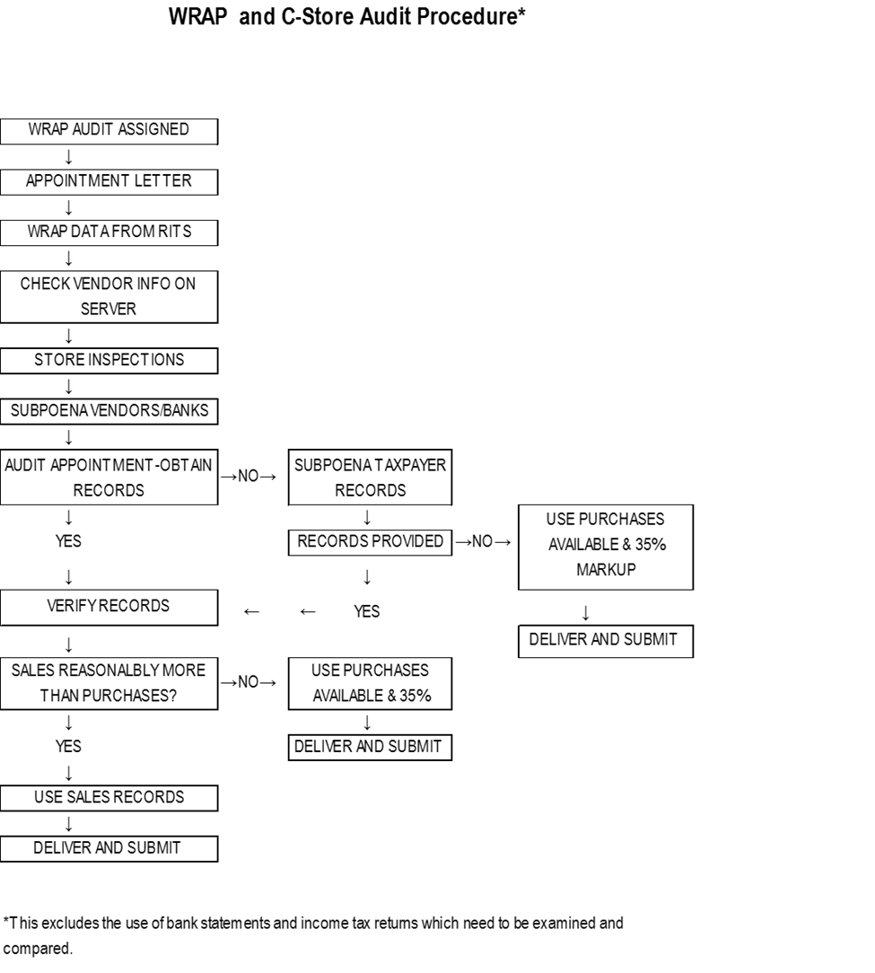

Slide 19
WRAP Results to date:

Slide 20
Additional tidbits
Currently, we have vendors/distributors that voluntarily report all of their sales (including groceries and non alcoholic purchases)
  These sales are used by the Field Audit Section as an audit tool
The Alabama Beverage Control Board requires licensed retailers to maintain on premise 12 months of purchase invoices. The retailer should also have available three years worth of purchase information upon request.

Slide 21
WRAP Unit contact information
WRAP Contact #: 334-353-0440
WRAP Email: wrap@revenue.alabama.gov
WRAP Personnel:
Shirley Aiken, Examiner
Bill Crownover, Examiner
Tina Miller, Examiner
Lori Price, Examiner
Leslie Rollins, Examiner
Brenda Champlin, Accounting Technician
Amy Jordan, Accounting Technician
Rosalie “Rose” Popwell, Accounting Technician
Kayla Montgomery, Administrative Assistant
Lee Ann Rouse, Manager
334-353-8411
Leeann.Rouse@revenue.Alabama.Gov

